Slide 1
Analysis of Bicycle Purchasers' Consumer Behavior
Analysis of Consumer Behavior of Bike Buyers

Slide 2
Objective: To identify key factors influencing bike purchases across customer segments, optimize marketing strategies, and tailor product offerings to increase sales and expand customer reach effectively.
𝗦𝗸𝗶𝗹𝗹𝘀 𝗔𝗰𝗾𝘂𝗶𝗿𝗲𝗱:
🔹𝗗𝗮𝘁𝗮 𝗖𝗹𝗲𝗮𝗻𝗶𝗻𝗴: Power Query
🔹𝗗𝗮𝘁𝗮 𝗠𝗼𝗱𝗲𝗹𝗶𝗻𝗴: Power Pivot
🔹𝗔𝗱𝘃𝗮𝗻𝗰𝗲𝗱 𝗘𝘅𝗰𝗲𝗹: VLOOKUP, XLOOKUP, INDEX MATCH, if formula
🔹𝗗𝗮𝘁𝗮 𝗔𝗻𝗮𝗹𝘆𝘀𝗶𝘀: Focused on consumer analysis
🔹𝗥𝗲𝗽𝗼𝗿𝘁 𝗖𝗿𝗲𝗮𝘁𝗶𝗼𝗻: Built user-friendly and interactive reports

Slide 3
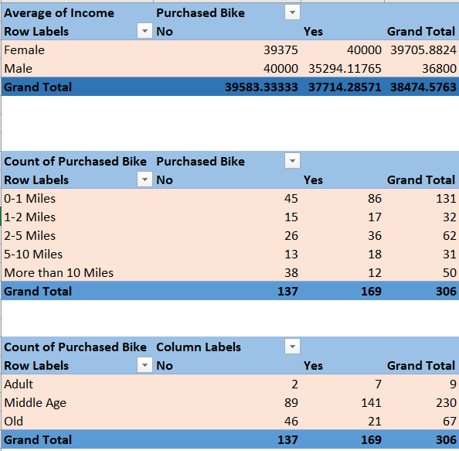
Insights:
On average, women who bought bikes make somewhat more ($40,000) than those who didn't ($39,375).
When compared to women, men who bought bikes make less money ($35,294) than those who didn't ($40,000).
When buying a bike, proximity is important; 86 out of 169 buyers (50.9%) reside 0–1 miles from the store.
There are fewer purchases as the distance rises. There were just 12 purchases from clients who lived more than ten miles away.
The majority of bike purchases—141 out of 169, or 83.4% of total purchases—are made by middle-aged consumers.
Old customers (21 purchases) and adults (7 purchases) have significantly lower purchase counts, indicating age preferences.

Slide 4
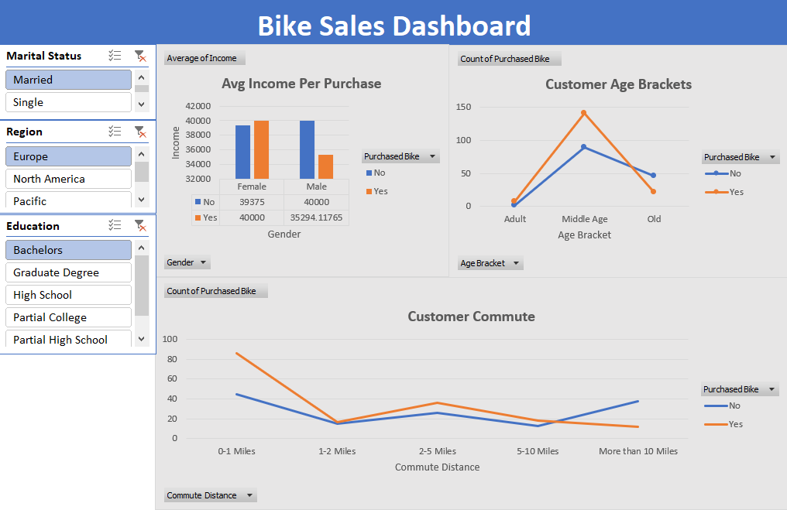

Slide 5
Recommendation:
Strengthen marketing campaigns targeting middle-aged customers, as they represent the largest segment of bike buyers.
Offer loyalty programs or personalized discounts to retain and engage this demographic.
Enhance visibility in neighborhoods within 5 miles of the store, as the majority of purchases come from this range.
For customers living more than 5 miles away, introduce delivery options, financing plans, or travel-based incentives to overcome the distance barrier.
Engage older customers and adults through targeted promotions (e.g., health benefits of biking for seniors or discounts for young professionals).
Use the insights from proximity and income to tailor messaging for these underperforming age groups.

